Slide 1



DS Project Review-2
Government Grievance & Public Sentiment Analysis System
11-09-2026
Under the Guidance of
Dr. N. Sunanda
Department of Computer Science and Engineering,
KLH CSE Bowrampet Campus
Team Members
B. Chetna – 2420030098
J. Nandini – 2420030262
S. Sai Saranya – 2420030266
DS Project Review-2
1

Slide 2

Outline of Project Work
Focus
  Introduction
    Literature Survey
      Challenges
        Research Objectives
          Conclusion & Future Work
            References
              Publications Details
2

Slide 3
Problem Statement
Government grievance data contains valuable information about public issues,
but raw complaint text is difficult to analyze directly.
Citizen complaints may contain missing values, duplicate records and
unnecessary information.
Complaint text is unstructured, making it difficult to group complaints into major
public-service categories.
It is difficult to quickly determine whether citizen feedback is positive, negative
or neutral.
Complaint volumes and sentiment can change over time, so trend analysis is needed.
A simple, interactive dashboard is needed to convert raw grievance data into understandable insights.

Slide 4
Objectives
Collect, clean and preprocess government grievance data by handling missing
values, duplicate records and unnecessary information.
Apply NLP and Machine Learning to process citizen complaints and classify them into categories such as Roads, Water Supply, Electricity, Healthcare, Education and Transportation.
Perform Sentiment and Trend Analysis to identify Positive, Negative and Neutral
feedback and understand complaint patterns over time.
Develop an interactive Streamlit dashboard to visualize complaint categories, sentiment distribution, trends and key insights.

Slide 5
Literature Survey
Authors | Title of the Paper | Methodology | Inferences | Limitation/Future work
Pang, Lee & Vaithyanath an | Thumbs up? Sentiment Classification using Machine Learning Techniques | Naive Bayes, Maximum Entropy, SVM | Machine learning can effectively classify text into sentiment categories. | Mainly focuses on movie reviews; government grievance-specific analysis can be explored.
Medhat, Hassan & Korashy | Sentiment Analysis Algorithms and Applications: A Survey | Lexicon-based and Machine Learning approaches | Provides an overview of different sentiment analysis techniques and applications. | Sentiment analysis can be affected by domain and language complexity.
Devlin et al | BERT: Pre-training of Deep Bidirectional Transformers for Language Understanding | Transformer-based NLP | Contextual language models provide strong performance in text understanding. | Requires higher computational resources compared with basic ML approaches.
5

Slide 6
Problem Gap Identification
Existing sentiment analysis systems mainly focus on identifying the sentiment of text.
Existing grievance systems may focus on collecting and managing complaints without deeper sentiment
analysis.
Raw government grievance data requires proper cleaning and preprocessing before analysis.
There is a need to combine complaint classification and sentiment analysis.
Complaint frequency and sentiment should also be analyzed according to time-based trends.
A simple interactive visualization can make these insights easier for users to understand.
Identified Gap
CivicSense combines grievance analysis, complaint classification, sentiment analysis, trend analysis and
interactive visualization into a single Data Science workflow.

Slide 7
Innovation, Creativity, and Novelty
INNOVATION
Integrated Data Science: Combines data cleaning, NLP, Machine Learning and visualization in one
system.
Automated Complaint Analysis: Automatically classifies citizen complaints into public-service
categories and identifies their sentiment.
CREATIVITY
Citizen-Centric Analysis: Focuses specifically on real government grievances such as roads, water, electricity, healthcare, education and transportation.
Interactive Insights: Uses a Streamlit dashboard with charts, graphs, filters and statistics to make
complex grievance data easy to understand.
NOVELTY
Unified Data Science Workflow: Combines grievance analysis + complaint classification + sentiment analysis + trend analysis + visualization in a single system.
Time-Based Insights: Goes beyond individual complaints by analyzing how complaint frequency
and sentiment change over time.

Slide 8
Proposed System Architecture
1. Data Acquisition
Collect government grievance records and labeled sentiment data.
Sources may include CPGRAMS or publicly available state grievance portals.
2. Data Cleaning
Handle missing values, duplicates, irrelevant fields, and inconsistent formats.
Prepare a clean dataset for analysis.
3. NLP & Feature Extraction
Clean and normalize complaint text.
Apply TF-IDF to convert text into numerical features.
4. Machine Learning Analysis
Complaint Classification: Categorize complaints into roads, water supply, electricity, healthcare, education, transportation, and other services.
Sentiment Analysis: Classify feedback as positive, negative, or neutral.
Technology Stack: Python, Pandas, NumPy, Scikit-learn, NLP

Slide 9
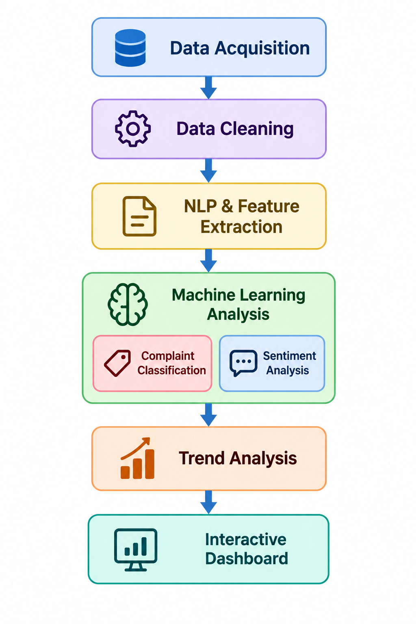
Trend Analysis & Visualization
5. Trend Analysis
Calculate daily, weekly, and monthly complaint counts.
Identify frequently reported service categories.
Analyze sentiment distribution and changes over time.
6. Interactive Dashboard
KPI Cards: Total grievances and sentiment counts.
Bar Chart: Complaints by service category.
Donut Chart: Positive, negative, and neutral sentiment.
Line Chart: Complaint trends over time.
Filters & Complaint Explorer: Search records by date, category, and sentiment.
Technology Stack: Streamlit, Plotly, Matplotlib
Expected Outcome: Transform grievance records into understandable insights that help identify recurring public-service issues.

Slide 10
Algorithms and techniques
1. TF-IDF (Term Frequency–Inverse Document Frequency)
TF-IDF converts complaint descriptions into numerical features that machine-learning models can understand. It assigns importance to words based on their frequency in a complaint and how common or rare they are across the dataset.
Purpose: Text feature extraction.
Example: Words such as “pothole,” “drainage,” and “electricity” may help distinguish complaint categories.
2. Logistic Regression
Logistic Regression is a supervised machine-learning algorithm used to predict a class based on input features.
It is used for classification.
Purpose: Predict complaint categories and sentiment labels.
Complaint classification: Predicts one of eight categories, including Roads, Water Supply, Electricity, Healthcare, Education, Transportation, Drainage / Sewage, and Other Public Services.

Slide 11
Sentiment analysis: A separately trained model predicts Positive, Negative, or Neutral sentiment.
Advantage: Efficient, interpretable, and suitable as a baseline for TF-IDF text classification.
3. Train-Test Split
Train-test split divides labeled data into two parts:
One for training the model and another for evaluating its performance on unseen examples.
Training set: Used to fit the TF-IDF vectorizer and train Logistic Regression.
Testing set: Used to measure how well the trained model generalizes to unseen complaints.
Purpose: Helps evaluate the model fairly and identify overfitting.
4. Data Aggregation for Trend Analysis
Data aggregation groups complaint records according to fields such as date, category, and sentiment, then calculates summary statistics.
Calculates daily, weekly, and monthly complaint counts.
Identifies frequently reported service categories.
Examines sentiment distribution across categories.
Tracks changes in complaint frequency over time.
Example: Counting complaints each month to examine whether their frequency changes.

Slide 12
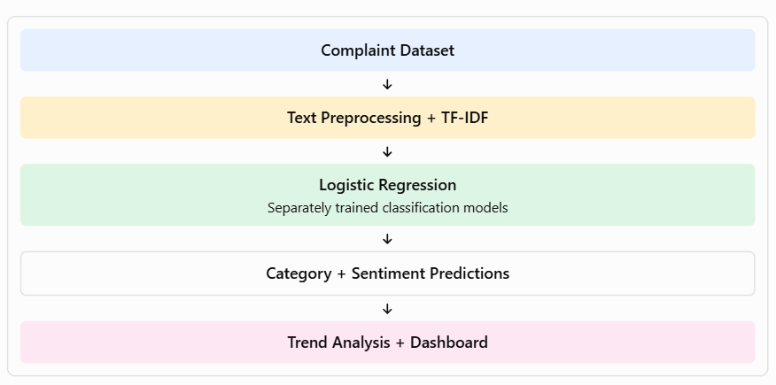
Algorithm flow

Slide 13


